Slide 1
Containerization as an Open Science tool
Nicolas Lefebvre – Dassault Systemes Solidworks

Slide 2
Why should I even listen to you?
Disclaimer: like the other Nicolas, but worse:
Master’s degree in Computer Science with a focus on Software Architecture
But not a PhD, scientist or researcher in any way
But a frequent user of containerization for:
Cloud service development
DevOps (CI/CD) pipelines
Internal tooling
General “I like to experiment without blowing up my dev environment”
Containers made my job easier; maybe they can help you too?
Notes:
Introduction
Mention this talk is my own and is not related to my employer
Clarify that you don’t need to understand everything, don’t need to read every detail, don’t need to understand all the diagrams in depth
Set expectations. We’ll talk about:
Why you might want to use containers
How they solve open science problems
What other types of problems they might be useful for
How to use them in practice
We WON’T talk about:
Higher level tools (orchestration)
Details of using the Docker CLI

Slide 3
What problem are we even solving?

Slide 4

Has this happened to you?
You want to run existing code you didn’t write and you’d like:
Ideally, I would just start project.sh and have it spit out some results…
Oh, this project has no documentation on how to build or install it. Or launch it.
Or it does, but the documentation is out of date and following exactly fails!
Well, I just need to install this one <library / Python package / driver> to get it to work, this should be easy…
I finally got it working. It would be nice if this was easier next time!

Slide 5
The four problems we’re solving
Ease of use: starting the project should be a single command
Documentation: instructions to build and run the project should be a machine readable recipe
Dependency hell: solving dependencies should be expressed explicitly in the recipe; the recipe should be repeatable across time and environments
Archival: The result of the recipe should be archivable by itself for later use
Notes:
Based on the previous scenario, containers can help you solve four related problems we just encountered

Slide 6
Demo: containers as a dev tool
Notes:
Handwavy magic demo of using containers as a dev environment for Nicolas’ Python code.
docker run -it --rm -p 8888:8888 -v ${pwd}:/app continuumio/anaconda3 bash
jupyter notebook --notebook-dir=/app --ip='*' --port=8888 --no-browser --allow-root

Slide 7
Wait, what even are containers anyway?
An OS level virtualization technology offering:
Process space isolation
Network isolation
File system isolation
Performance
A set of tools define, share, run, and manage container blueprints (“images”) and containers:
Images are defined in a human readable, machine executable format
Images can be shared as pre-built binary blobs with efficient storage and distribution
Containers can easily be spawned from images and are transient
Notes:
Now that we’ve briefly used containers… what actually IS a container?
Performance: a container is, fundamentally, just a process
OS native technology (LXC, under Linux)
From the inside, a container looks reasonably like a VM or bare metal

Slide 8
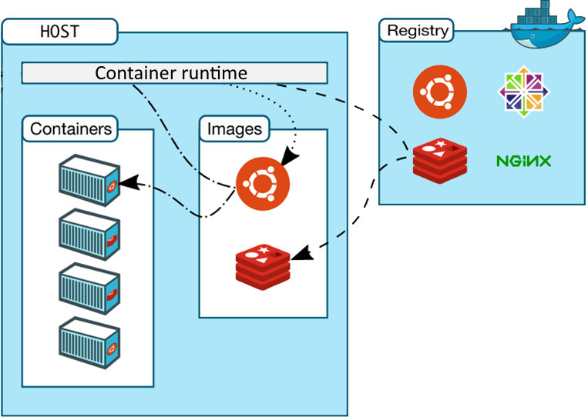
A brief terminology detour
Containers are the running processes and their isolation wrapper
Images are binary blobs to be instantiated as containers
Dockerfiles define how to create an image
Container runtimes build, upload, download, and run containers
Registries store images
Notes:
Running a container is the act of eating a cake
The image is the cake
Dockerfiles / recipes / blueprints are the recipe for the cake
You can get a cake from the bakery (registry) without knowing the recipe. Even if you do know it, if you have the cake / image, you don’t need to apply the recipe again before eating the cake / running the image as a container, since you already have the cake!
(this analogy works weirdly well for security, too: if you don’t know the recipe, the cake could be poisonous. Even if you do know the recipe, there’s no guarantee a given image actually IS the recipe, and not a different thing with poison in it, technically!)
Source : Docker documentation (modified)

Slide 9
So how do containers solve our problems?
Ease of use:
Simple command line interface to download and run a container image
Options to customize runtime behavior
Documentation:
Container images are created from text based definitions
These act as living documentation of how to build and run a project
They can be version controlled
Dependency hell:
Image definitions are not a silver bullet => you’ll still need to solve the problem…
But you’ll only be solving it once, and you’ll be documenting how while you do it
Archival:
Image registries store built images for future use
Registries are effective at distributing (potentially large) images
Registries integrate well with CI/CD tools for automated archival

Slide 10
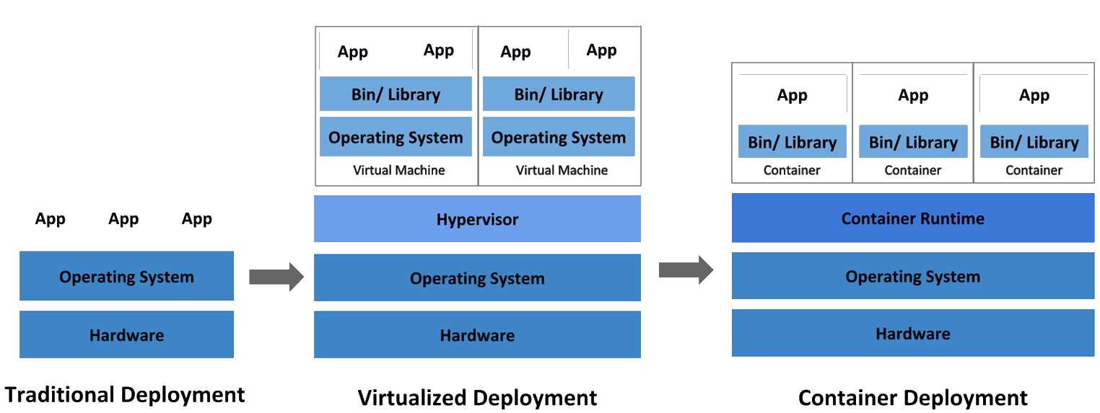
What other problems are people solving?
Across the software industry, containers are useful for:
Isolation
Continuous Deployment
Reliability
Notes:
As context, this slide gives a brief overview of what other people are doing with containers, and why. Probably not of interest to this audience at this time, but it is useful to place containers in the broader context of software development.
YOU DON’T NEED TO UNDERSTAND THIS DIAGRAM. A historical perspective on why containers exist is interesting context, not a requirement for anything.
Containers are an evolution of existing deployment models and naturally result from the historical progression from individual servers to VMs onwards.
Source: Google (https://kubernetes.io/docs/concepts/overview/what-is-kubernetes/)
Containers are “cattle, not pets”: is an application fails or misbehaves, it can be restarted transparently (in theory)
In these models:
Bare metal deployment: if an app goes down, it’s an annoyance, and possibly a manual process to restart it. If the OS or hardware go down, it’s a disaster
VM deployment: if the OS goes down, the hypervisor can automatically restart it; if the app goes down, still possibly a manual process
Container deployment: if a container goes down, the container runtime can restart it, restarting the app cleanly. Containers can be killed and replaced whenever needed

Slide 11
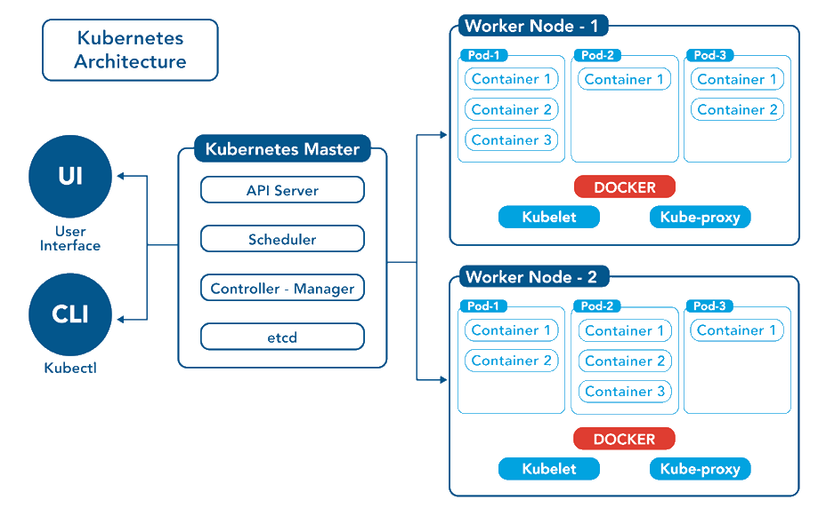
What will containers NOT do for me?
Containers are a tiny part of a broader ecosystem
In large projects, multiple containers might form higher level components (apps, services, etc)
Defining relationships between containers (dependencies, communication, co-location, etc.) is outside the scope of a container runtime
All of this is a job for container orchestration
… but you probably don’t need it
Notes:
Diagram for illustration of the complexity of K8S; not intended to be detailed or understood
Source: Kubernetes Documentation

Slide 12
How do I actually use this?

Slide 13
Running an existing container
Install a container runtime (i.e. install Docker Desktop, probably)
docker run hello_world
docker run ghcr.io/ezekiel-da/containerization_example
docker run ghcr.io/ezekiel-da/containerization_example –p 8888:8888

Slide 14
Building and publishing a container image
Define your Dockerfile
docker build . -t <image_name>
docker push <image_name>
Notes:
We’ll see how to define a Dockerfile in a second in the 2nd demo

Slide 15
Demo: containerizing open source code

Slide 16
Questions?
E.g:
Docker vs containers (OCI)
Linux containers on a Windows host
Windows containers
Security
Volumes, ports

Slide 17
Thank you!

Slide 18
Links
https://opencontainers.org/
https://www.docker.com/
https://podman.io/
https://github.com/Ezekiel-DA/containerization_example
https://reproducible-analysis-workshop.readthedocs.io/en/latest/8.Intro-Docker.html
Carl Boettiger (2015), An introduction to Docker for reproducible research, with examples from the R environment, ACM SIGOPS Operating Systems Review, Special Issue on Repeatability and Sharing of Experimental Artifacts. 49(1), 71-79, doi: 10.1145/2723872.2723882

